Slide 1


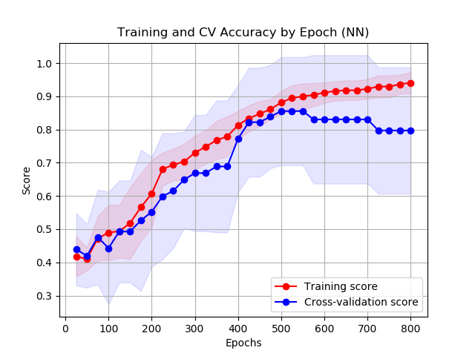
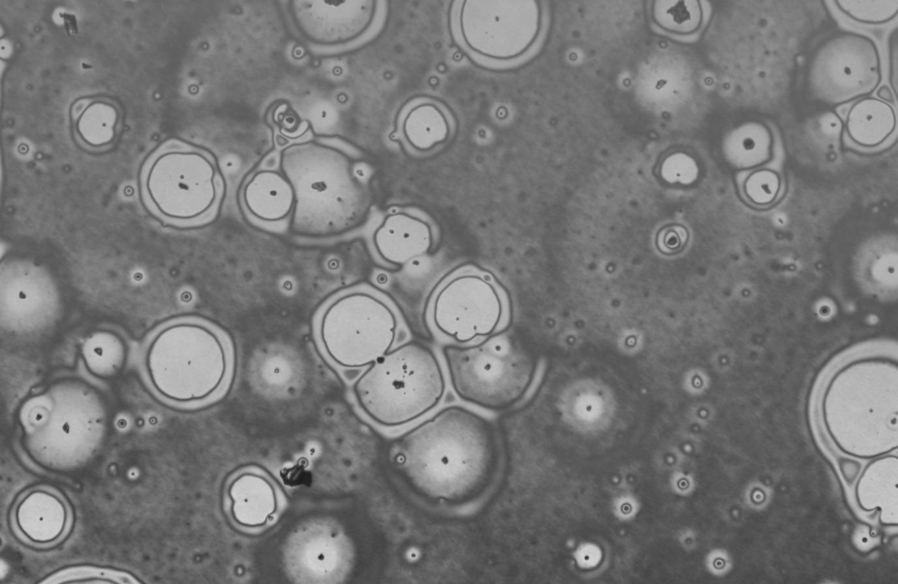
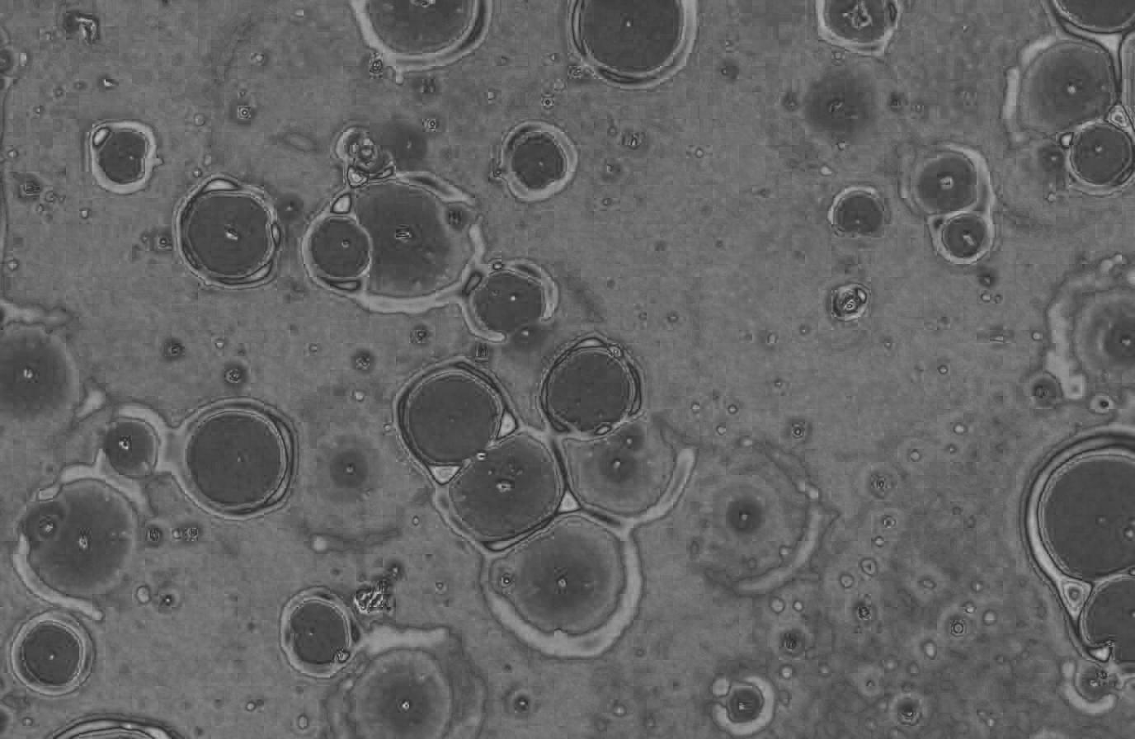
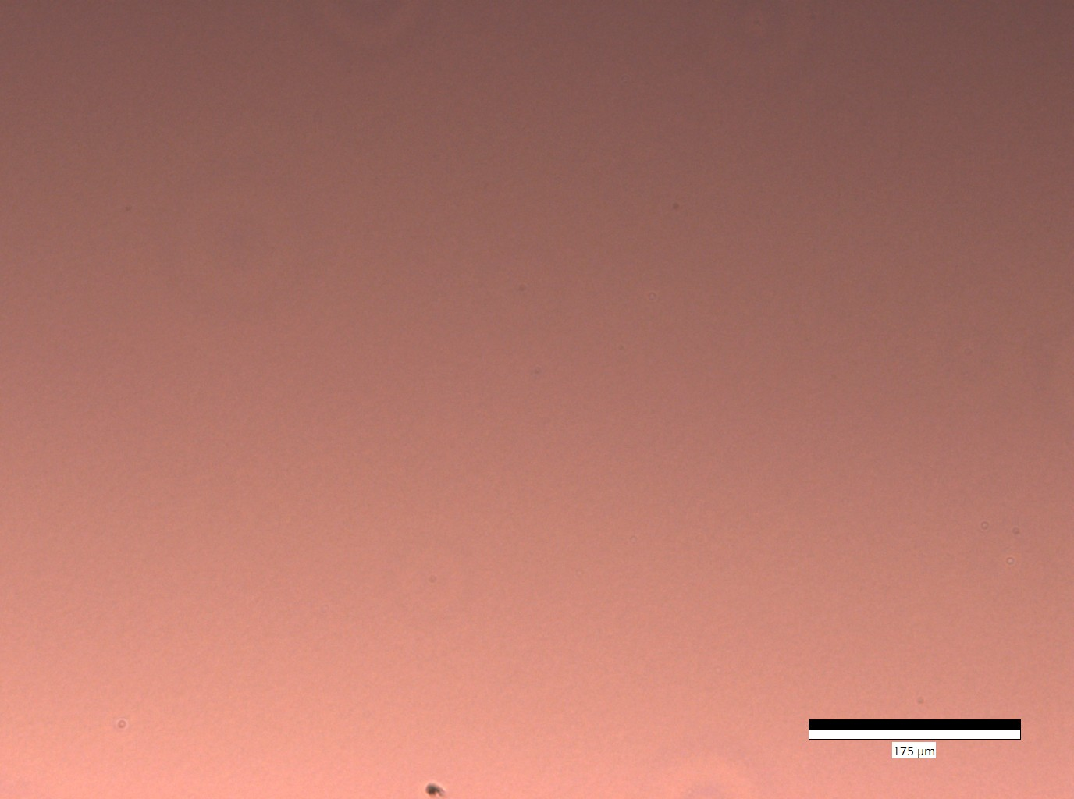
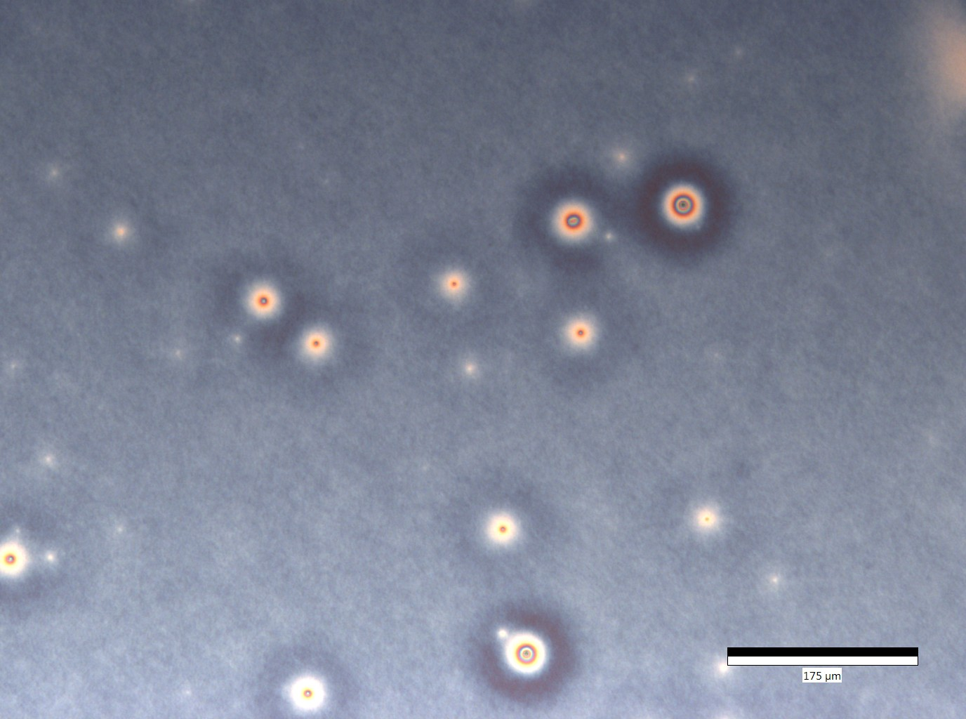
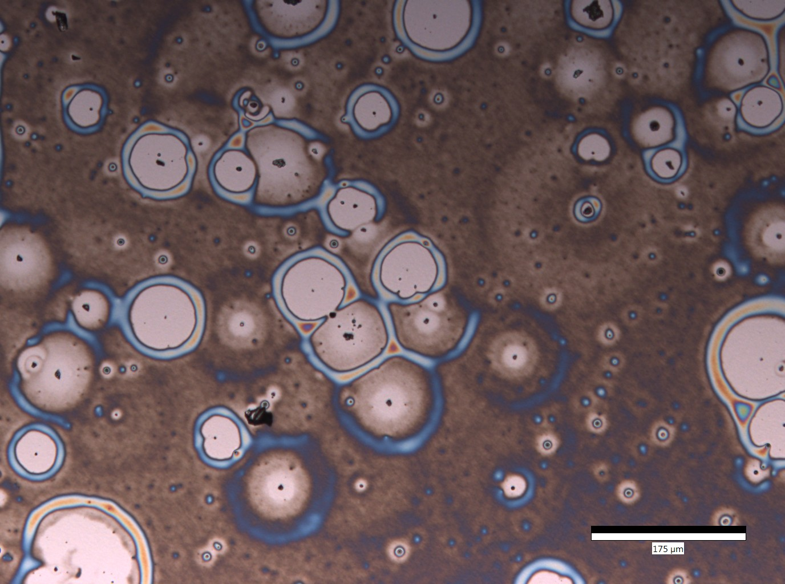
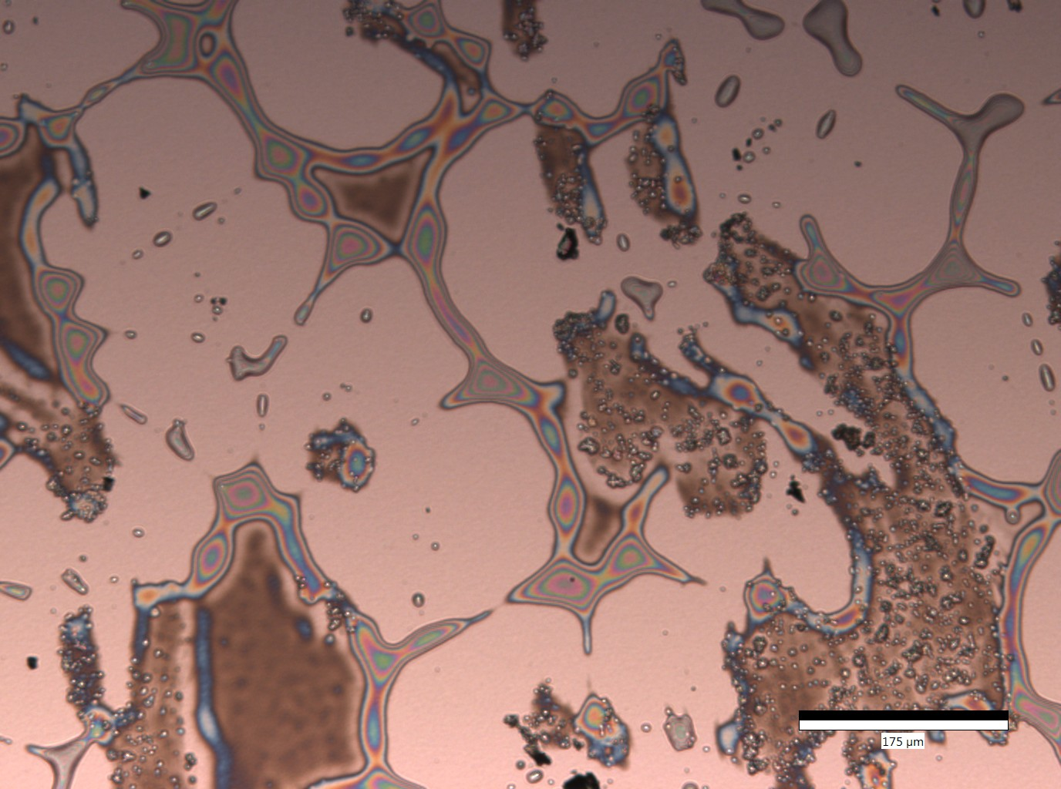
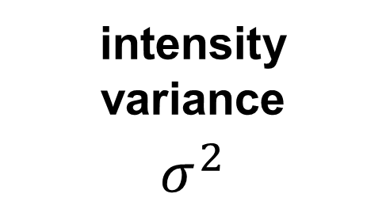
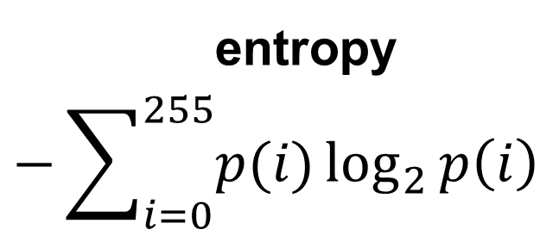
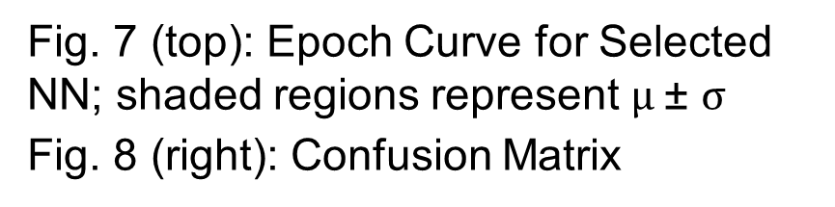
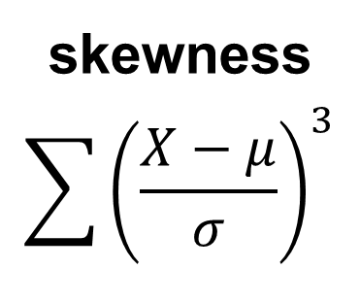
Image Classification of Dewetting Microscopy
Using Artificial Neural Networks
¹ Kim C, ² Sutrisno R, ³ Chua K, ⁴ Karim A, ² Toti G
¹ Brown University, Providence, RI; ² Department of Computer Science, University of Houston, Houston, TX;
³Cornell University, Ithaca, NY; ⁴ Department of Chemical and Biomolecular Engineering, University of Houston
ABSTRACT
FEATURE EXTRACTION
RESULTS
Contemporary methods to analyze dewetting stages from optical microscopy are limited to manual classification. The project seeks to automate this process by using image processing techniques and machine learning. Magnitude independent features, such as pixel skew, variance, and entropy, along with their local deviations, were used to train a simple feed forward neural network. From a dataset of 64 images, tuning was achieved by selecting the neural network hyperparameter configuration with the highest peak cross validation score. The selected model accurately classified approximately 80% of the testing set.
1. Convert to grayscale and saturation images
Highest CV Model
Architecture: (12,8,8,4)
Regularization: L1(10⁻³)
Epoch: 500
Accuracy Metrics
*20% of dataset was reserved
for testing
Training: 0.882 ± 0.035
Validation: 0.855 ± 0.163
Testing: 0.786
2. Apply Mean Filter Normalization (MFN) to reduce microscopy artifacts
Score
Epoch
0
  1 2 3 4
1 1 0 0 0
2 0 1 2 0
3 0 0 4 0
4 0 0 1 5
Predicted
BACKGROUND
Fig. 5: Grayscale Image After MFN
Fig. 6: Saturation Image after MFN with Striding Grid Representation
Fig. 7 (top): Epoch Curve for Selected NN; shaded regions represent $μ \text{±} σ$
Fig. 8 (right): Confusion Matrix
Actual
Dewetting is a process that leads thin polymer coatings to separate from their substrate. It occurs when conditions are more favorable for molecules of a liquid to coalesce.
Chemical engineers are interested in determining what conditions bring to different degrees of dewetting.
Machine learning can be used for classification of dewetting stages.
3. Calculate magnitude independent features from entire image
intensity variance
$$σ^{2}$$
entropy
$$−\sum_{i=0}^{255}{p(i)\log_{2}{p\left(i\right) }}$$
skewness
$$\sum{{\left(\frac{X−μ}{σ}\right)}^{3}}$$
CONCLUSIONS
Meaningful supervised learning is evident.
Decision boundary between class 2 and 3 needs improvement.
Proximity of training and cross-validation accuracies suggest model is not overfitting to the training sample.
4. Quantify homogeneity by calculating local deviations of features with respect to global
= 12 features
n=4
n=11
NEURAL NETWORK (NN)
FUTURE WORK
1
2
Grid Search Hyperparameter Space:
Increase training set size to enhance performance
Test robustness of model across different polymer and image acquisition methods.
Architecture
Regularization
12
Hidden
Layers
4
None
L1
L2
ACKNOWLEDGEMENTS
n=25
n=23
Penalties @ 10⁻³,10⁻⁴
3
4
1st Hidden Layer Nodes: 10, 8, 5
2nd Hidden Layer Nodes: 8, 5
This research was made possible by a NSF grant to the University of Houston Department of Computer Science.
= 30 models
5. Measure training and cross-validation (k=10) scores every 25 epochs up to 800 epochs
REFERENCES
6. Compare optimal cross-validation scores before overfitting across models
Meredith, J. C., Smith, A. P., Karim, A., & Amis, E. J. (2000). Combinatorial materials science for polymer thin-film dewetting. Macromolecules, 33(26), 9747-9756.
Raschka, S., & Mirjalili, V. (2017). Python machine learning. Packt Publishing Ltd.
Figs. 1-4: Dewetting Stages (None, Early, Intermediate, Late)

